Slide 1
Real-Time Big Data Analytics
David Smith
Revolution Analytics
@revodavid
From Deployment to Production

Slide 2
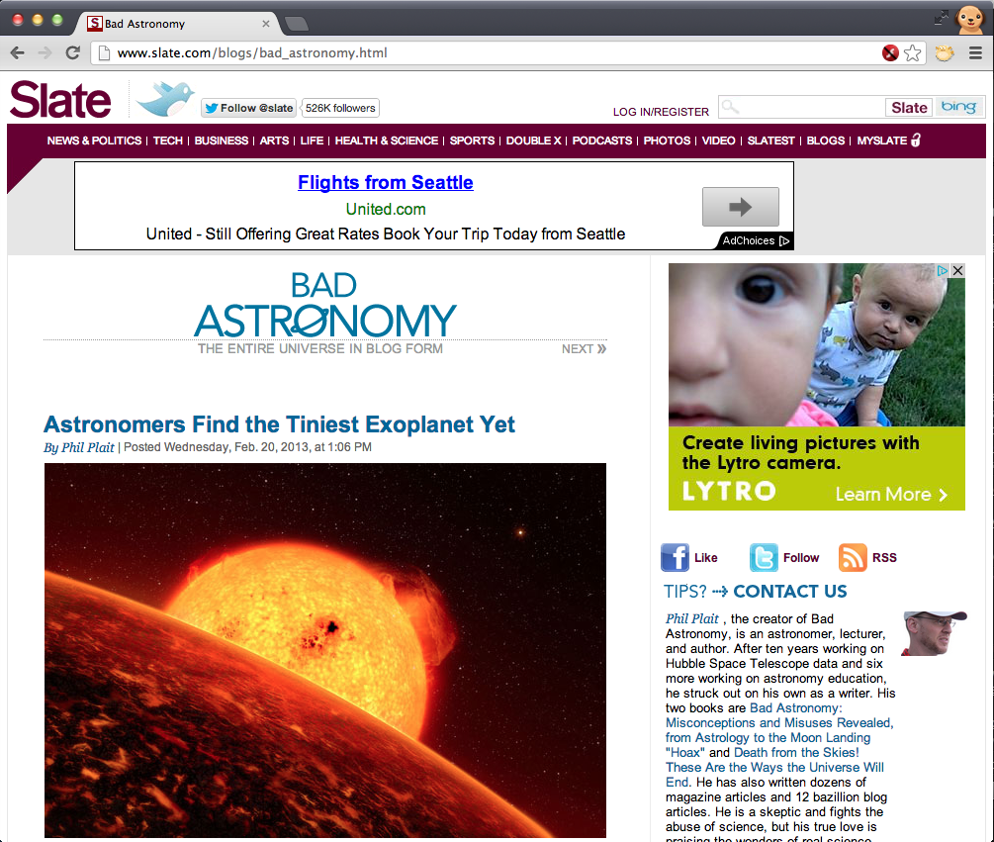
WHAT’S UP WITH THAT?

Slide 3
Buzzword Bingo!
REAL TIME
BIG DATA
PREDICTIVE ANALYTICS
Notes:
Get out your buzzword bingo cards!

Slide 4

Notes:
Data as “new oil” – valuable commodity
Big Data is crude oil: messy, hard to get at, got contaminants in it.

Slide 5


Predictive Analytics Model
Factors
User ID
Browser
Time/Date / Location
Previous purchases
Friend data
Any known information
Decision Tree
Logistic Regression
Neural Network
K-means clustering
Ensemble Model
Predictive Model
Scoring Rules
Scores
Product of most interest
Offer of most likely sale
Most relevant link
Forecast sale value
Optimal Bid
Prediction or Selection
Notes:
Start off with stuff we know in real time.

Slide 6

Real-time Deployment
Data distillation
Model development and validation
Model deployment
Real-time model scoring
Model refresh

Slide 7
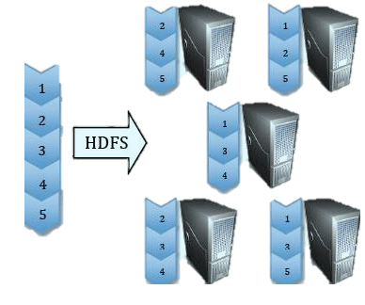


1. Data Distillation in Hadoop
Log Files
Structured Data
Sensor Streams
HDFS Load
Map-Reduce
rmr
Language Text
Unstructured
Data
Analytics Data Mart

Slide 8
2. The Model Development Cycle
Feature Selection
Sampling
Aggregation
Model Estimation
Model Refinement
Model Comparison / Bench-marking
Variable Trans-formation
Structured Data
Predictive Model
R White Paper
bit.ly/r-is-hot
Notes:
Model development process
Not just about the computational speed. Also about productivity of developer.

Slide 9
3: Deployment Options
Factors
Unknown factors
  SQL / Rules Engine
  Code (C++, Java, R, Hadoop)
  PMML Engine
Factors known in advance
  Batch Lookup Tables
Scores

Slide 10

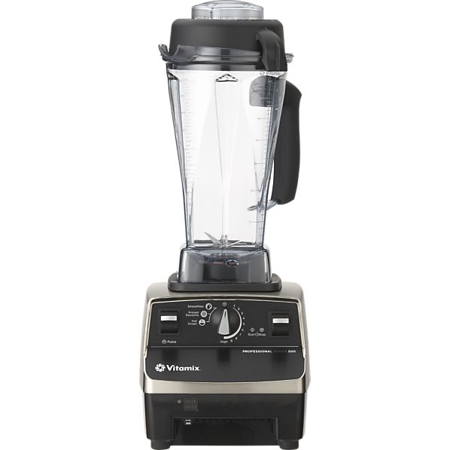
Why did I buy that blender?
Just browsing in the mall
TV ad / magazine ad
Coupon in the mail
“Just moved” promo email
Webstore recommendation
Browsing catalog

Slide 11
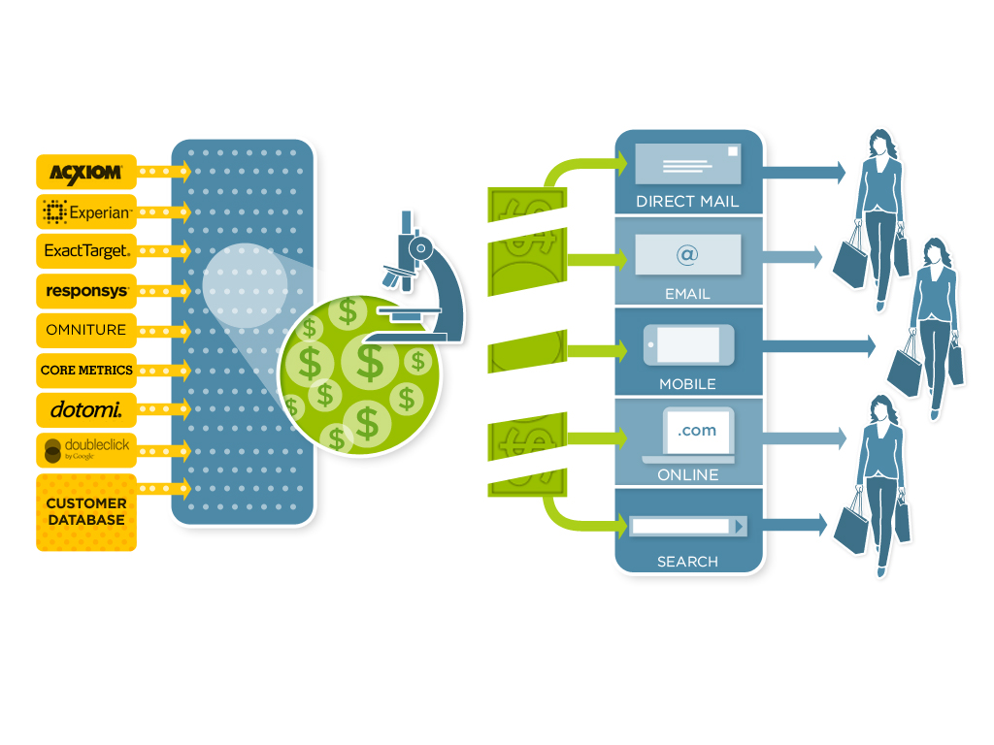

UpStream: Attribution Modeling
Notes:
Demographics: consumer, product, market
Actions: web clicks, email clicks, mobile app usage, call center logs, social, search …
Outcomes: impressions, touches, orders (retail, online, mobile)
Strategic allocation

Slide 12
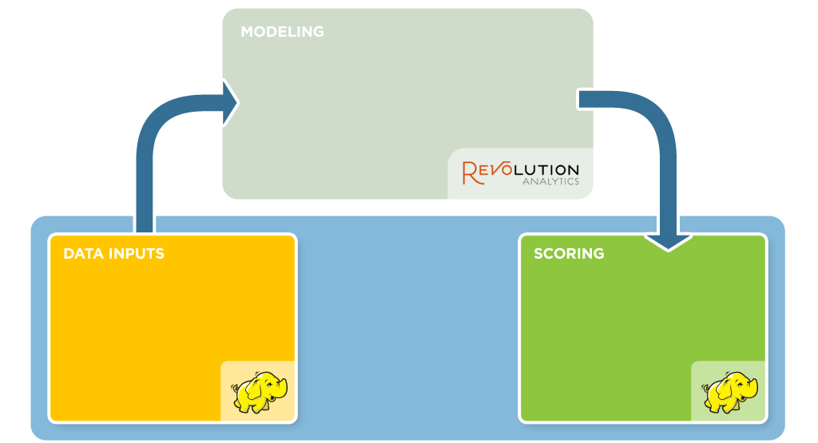
4. Model Scoring
Exploratory data analysis
Time-to-event models
GAM survival models
UpStream Data Format
Custom Variables (PMML)
ETL
Marketing channel data
Behavioral variables
Promotional data
Overlay data
Scoring for inference
Scoring for prediction
5 billion scores per day
per retailer
Notes:
Outcome is “buying” instead of “dying”

Slide 13
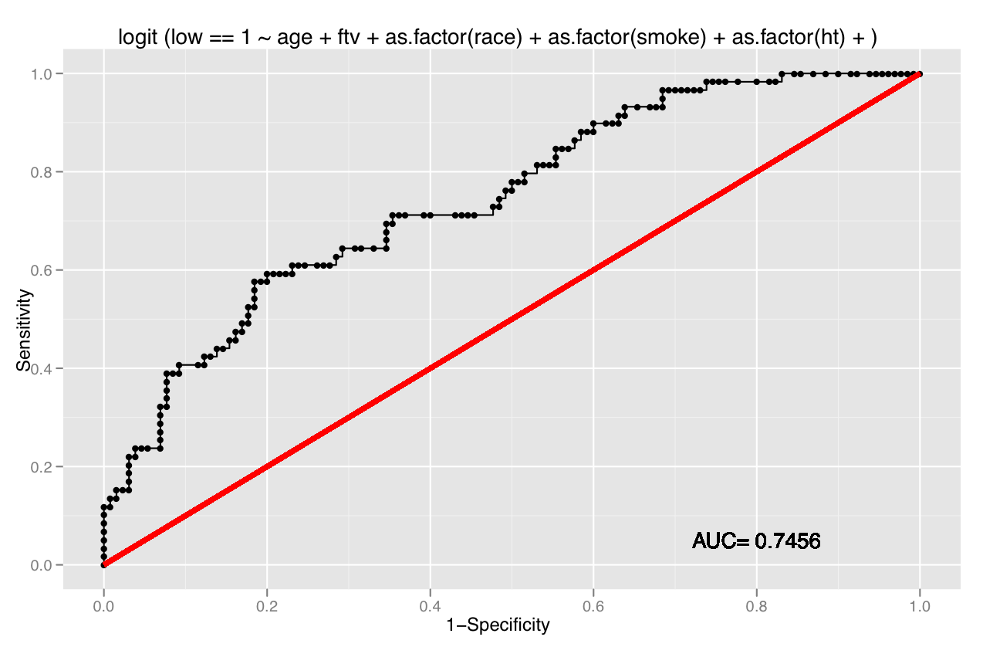
5. Model refresh
Factors
Scores
Actual Outcomes

Slide 14
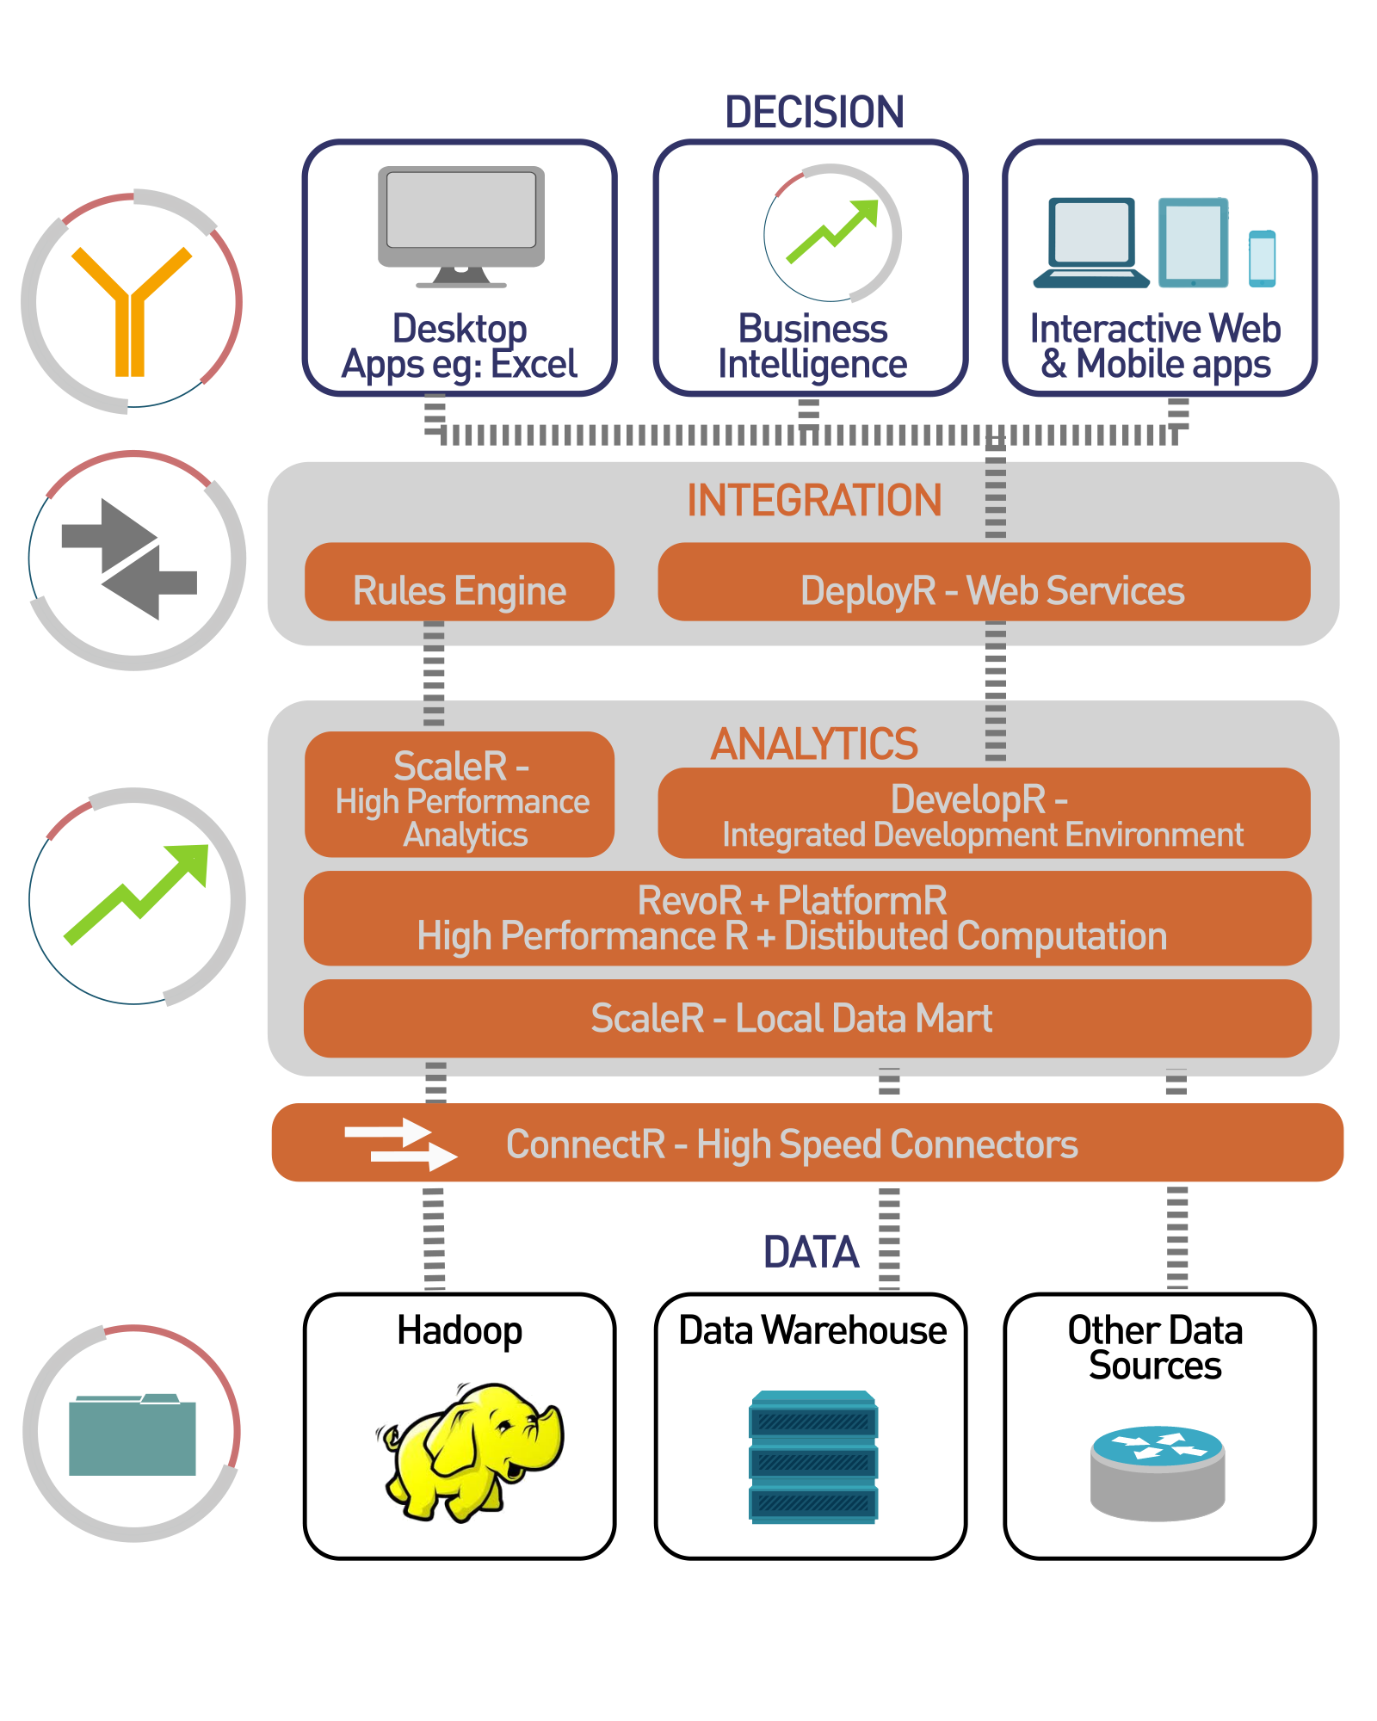
Big Data
Real Time
Kilobytes/Sec
Seconds
Megabytes/Sec
Milliseconds
Gigabytes ➔ Terabytes
Minutes
Petabytes ➔ Exabytes
Minutes ➔ Hours

Slide 15
PREDICTIVE ANALYTICS
WHAT’S UP WITH THAT?
BIG DATA
REAL TIME

Slide 16

Real-Time Big Data Predictive Analytics: From Deployment to Production
David Smith
@revodavid
The leading enterprise provider of software and services for Open Source R
Booth 618 / Office Hours Weds 1:30PM
www.revolutionanalytics.com
+1 650 646 9545
Twitter: @RevolutionR
Notes:
From Revolution Analytics. We help companies deploy predictive models created in R to real-time production systems.

